Slide 1
Binary Trees
TIP101
Notes:
🌟 Purpose: Welcome students and introduce the focus of the session on binary trees.
✅ What should I be doing?
Greet students warmly and set a positive tone for the session.
Briefly introduce the topic and its importance.
🎙 What should I be saying?
Welcome to Week 8 of TIP101! Today, we’ll be exploring binary trees, one of the fundamental data structures in computer science.
Binary trees are incredibly versatile and show up in everything from search algorithms to organizing data efficiently. By the end of today, you’ll understand the basics and know how to manipulate them.
🙌🏽 How should I engage students?
Use humor or enthusiasm: "Who’s ready to tackle some tree problems and branch out their skills?"
Encourage questions right from the start to create an interactive environment.

Slide 2
1 | Welcome 👋🏽 | 10 minutes
2 | Binary Trees | 35 minutes
3 | BREAK | 5 minutes
4 | Collaborative Problem Solving | 60 minutes
5 | Wrap Up | 10 minutes
Notes:
🌟 Purpose: Provide an overview of the session and structure.
✅ What should I be doing?
Walk through the agenda to set clear expectations for the session.
🎙 What should I be saying?
Here’s what we’ll cover today: We’ll start with an introduction to binary trees, then dive into collaborative problem solving. Afterward, we’ll wrap up with some reflections and reminders for the week.
Our focus will be on understanding binary trees and binary search trees, and we’ll also practice node insertion and deletion.
🙌🏽 How should I engage students?
Ask: "Does anyone have any specific questions or topics they’d like us to cover during the session?"

Slide 3
Welcome! 👋🏽
10 minutes

Slide 4


Turn on your cameras
Fill out the entry ticket
Notes:
🌟 Purpose: Encourage visual engagement to foster connection during the session.
✅ What should I be doing?
Prompt students to enable their cameras and submit the entry ticket.
🎙️ What should I be saying?
Let’s kick off our session by turning on our cameras!
Also, don’t forget to fill out the entry ticket to help us organize breakout rooms later.
🙌🏽 How should I engage students?
Use humor or compliments: "Let’s see those smiles!"
Acknowledge and thank students who turn on their cameras.

Slide 5
2 minutes
📱Question:
Have you ever tried or wanted to try mobile development? Are you team iPhone or Android?
💬Answer:
Share your answer in the Zoom chat below. What kinds of pets do you have if any? If you don’t have any, share what type you would like to have, if any.

Slide 6
Recursion foundations went well, building on that this week!
Students appreciated peer to peer experience
- Interview + Breakout rooms seems a bit heavy
- [Followup] More Interview Prep Resources: Hackerank
Notes:
🌟 Purpose: Share feedback from the previous session and highlight areas of success and improvement.
✅ What should I be doing?
Summarize feedback from the previous session's survey and present key takeaways.
🎙️ What should I be saying?
From your feedback, it seems many of you enjoyed [highlighted aspect]. One suggestion was [area for improvement]. We’ll work on that today.
🙌🏽 How should I engage students?
Ask: "Does anyone have additional feedback or suggestions?"

Slide 7

Announcements & Reminders
Problem Set Validator email sent out a few hours ago
We will demo right before the break!
Totally optional tool that we built based on you guys’ feedback.

Slide 8
Binary Trees
35 minutes

Slide 9
In the chat . . .
What do you already know about binary trees or binary search trees?
Notes:
🌟 Purpose: Encourage students to share their prior knowledge about binary trees and binary search trees to activate prior learning and foster engagement.
✅ What should I be doing?
Facilitate an open discussion in the chat to gather input from students.
Acknowledge and build on student contributions to create a collaborative learning environment.
🎙 What should I be saying?
Before we dive into today’s lesson, let’s take a moment to reflect on what you already know about binary trees or binary search trees.
Type your thoughts in the chat. You can share any definitions, examples, or even questions you have about these topics.
Don’t worry if you’re not sure—this is just to get a sense of what we’re starting with and to help guide today’s discussion.
🙌🏽 How should I engage students?
Acknowledge responses: "Great point, [Student Name]! That’s exactly how binary search trees are structured."
Build on contributions: "Interesting! [Student Name] mentioned tree traversal. Can anyone expand on how we might traverse a binary tree?"
Address misconceptions: "I see a few people mentioning that binary trees can have more than two children—remember, binary trees are limited to two children per node."
Encourage quieter students: "If you’re not sure, take a guess! This is a judgment-free zone."

Slide 10
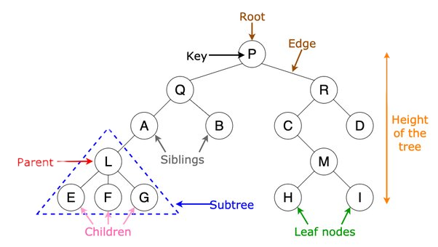
What is a Binary Tree?
Notes:
🌟 Purpose: Define binary trees and explain their structure.
✅ What should I be doing?
Introduce the concept of binary trees and explain key terminology (root, leaves, subtrees).
🎙 What should I be saying?
A binary tree is a hierarchical data structure where each node has at most two children: the left child and the right child.
The top node is called the root, and nodes without children are called leaves. A subtree consists of a node and all its descendants.
🙌🏽 How should I engage students?
Ask: "Looking at this structure, why do you think having two children per node might be useful for organizing data?"

Slide 11
In the chat . . .
What are some real-world examples where a binary tree structure might be useful?
Notes:
🌟 Purpose: Engage students in identifying real-world use cases for binary trees to help them connect the concept to practical applications.
✅ What should I be doing?
Facilitate an open discussion in the chat, encouraging students to brainstorm and share examples.
Build on their contributions to emphasize the versatility of binary trees.
🎙 What should I be saying?
Let’s think about how binary trees are used in real life. Can you come up with any examples where a binary tree structure might be useful?
Feel free to type your ideas in the chat. Think about scenarios where data is organized hierarchically or where efficient searching and sorting are important.
For example, binary trees are often used in decision-making processes or in databases for quick searches.
🙌🏽 How should I engage students?
Acknowledge responses: "Great example, [Student Name]! Yes, file systems often use tree structures, though they’re not always binary."
Add context: "Search engines and databases rely heavily on binary search trees to quickly find and sort information."
Expand: "Other examples might include AI decision trees, where binary trees model different decision paths, or network routing, where they optimize data traversal paths."
Challenge: "What happens if the binary tree is unbalanced in these real-world applications? How might that affect efficiency?"

Slide 12
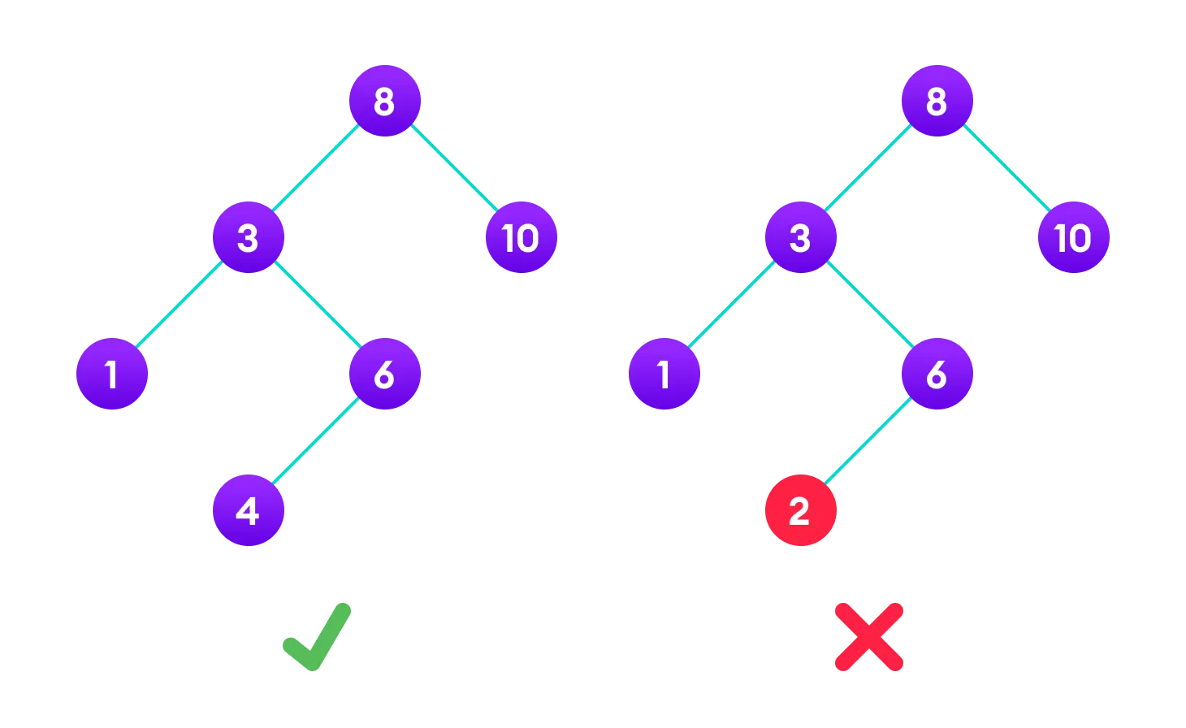
Binary Search Trees (BSTs)
Notes:
🌟 Purpose: Explain the properties and advantages of binary search trees.
✅ What should I be doing?
Highlight the ordered structure of BSTs and their applications.
🎙 What should I be saying?
A binary search tree is a special type of binary tree where the left subtree contains values less than the parent node, and the right subtree contains values greater than the parent.
This ordered structure allows efficient search, insertion, and deletion operations with an average time complexity of O(log n).
🙌🏽 How should I engage students?
Ask: "Can you think of examples where a BST might be more useful than a regular binary tree?"

Slide 13
How does the ordering in a BST help with search operations?
It allows you to search only the left subtree for all values.
It ensures that all values are stored in a sorted array.
It allows you to decide whether to go left or right based on the value you're searching for, reducing the number of nodes to check.
It makes the tree balanced automatically, leading to faster search times.
Notes:
🌟 Purpose: Assess student understanding of how the ordering property in a Binary Search Tree (BST) optimizes search operations.
✅ What should I be doing?
Read the question aloud to ensure clarity and engage students in thinking critically.
Allow students time to consider the options and respond in the chat or through a poll.
🎙 What should I be saying?
Let’s test our understanding of how the ordering property in a BST helps with search operations.
The question is: How does the ordering in a BST help with search operations?
Take a moment to think through the choices and let me know which answer you think is correct—A, B, C, or D.
Remember, in a BST, values in the left subtree are smaller than the root, and values in the right subtree are larger, which is crucial for efficient searching.
🙌🏽 How should I engage students?
Encourage participation: "Type your answers in the chat or submit your response in the poll. Let’s see what everyone thinks!"
Address misconceptions:
If students choose A: "Not quite—searching only the left subtree depends on the value being searched. What happens if the value is greater than the root?"
If students choose B: "Good thought, but while a BST can store values in a way that makes them appear sorted, it’s the left and right child relationships that matter for search efficiency."
If students choose D: "This would be helpful, but BSTs don’t guarantee balance automatically—that’s a feature of AVL or red-black trees."
Reinforce correct answer: "The correct answer is C. The ordering in a BST allows you to decide whether to go left or right based on the value you’re searching for, reducing the number of nodes you need to check. This property is what makes search operations in a BST efficient."

Slide 14
Why might you choose a BST over a general binary tree?
A BST requires less memory than a general binary tree.
A BST maintains an ordered structure, allowing for efficient search, insertion, and deletion operations.
A BST automatically balances itself, leading to faster operations.
A BST can store more nodes than a general binary tree.
Notes:
🌟 Purpose: Assess students' understanding of why binary search trees (BSTs) are preferred over general binary trees for certain operations.
✅ What should I be doing?
Read the question aloud to ensure students clearly understand the prompt.
Guide students in considering each option critically before selecting an answer.
🎙 What should I be saying?
Let’s think about why you might choose a binary search tree over a general binary tree.
The question asks: Why might you choose a BST over a general binary tree? Think about the properties of BSTs and what makes them unique.
Take a moment to review the options and share your answer in the chat or poll—A, B, C, or D.
🙌🏽 How should I engage students?
Encourage participation: "Feel free to explain your reasoning in the chat. If you’re unsure, take your best guess—we’ll break it down together."
Address misconceptions:
If students choose A: "Not quite. While memory usage might vary depending on the implementation, the key advantage of a BST lies in its structure and efficiency."
If students choose C: "Good thought, but BSTs don’t automatically balance themselves. That’s a feature of balanced binary search trees like AVL or red-black trees."
If students choose D: "This isn’t correct—a BST and a general binary tree can hold the same number of nodes. What makes a BST different is how the nodes are organized."
Reinforce correct answer: "The correct answer is B. A BST maintains an ordered structure, allowing for efficient search, insertion, and deletion operations. This property is why BSTs are so powerful for tasks like database indexing and searching."

Slide 15
The TreeNode Class
13
Each TreeNode contains a value, and references to its left and right children.
6
21
4
8
15
24
26
Notes:
🌟 Purpose: Introduce the implementation of a binary tree node in Python.
✅ What should I be doing?
Walk students through the class definition and example code.
🎙 What should I be saying?
This is how we define a TreeNode in Python. Each node stores a value and references to its left and right children.
Here’s an example where we create a root node with a value of 10 and add left and right children with values 5 and 15.
🙌🏽 How should I engage students?
Ask: "Looking at this class, how would you extend it to include additional metadata, like a parent pointer?"
Sample code to demo:
class TreeNode:
def __init__(self, key):
self.left = None
self.right = None
self.val = key
class ListNode:
def __init__(self, key):
self.val = key
self.next = None
# Creating a root node
root = TreeNode(10)
# Creating children nodes
root.left = TreeNode(5)
root.right = TreeNode(15)

Slide 16
Node Insertion
13
Value to Insert: 22
6
21
4
8
15
24
22
26
Notes:
🌟 Purpose: Demonstrate how to insert nodes into a BST while maintaining its properties.
✅ What should I be doing?
Walk through the pseudocode and implementation for node insertion.
Explain the decision-making process for placing the new node.
🎙 What should I be saying?
When inserting a new node, we compare its value to the current node’s value. If it’s smaller, we move to the left child; if it’s larger, we move to the right child.
This ensures the BST properties are maintained. The new node is inserted as a leaf node when we find the correct position.
🙌🏽 How should I engage students?
Ask: "Why do you think BSTs don’t allow duplicate values? How might that affect our insertion logic?"

Slide 17
Node Insertion Algorithm: Pseudocode
Start at the root.
Compare the value to be inserted with the current node’s value.
If the value is less, move to the left child; if greater, move to the right child.
Repeat steps 2-3 until the correct position is found.
Insert the new node as a leaf.
Notes:
🌟 Purpose: Explain the step-by-step process of inserting a new node into a Binary Search Tree (BST) using pseudocode.
✅ What should I be doing?
Walk students through each step of the pseudocode and explain how the BST properties are maintained during node insertion.
Use examples to illustrate the process.
🎙 What should I be saying?
Here’s the pseudocode for inserting a new node into a Binary Search Tree. Let’s break it down step by step.
Step 1: Start at the root of the tree. This is where the traversal begins.
Step 2: Compare the value to be inserted with the value of the current node. This comparison determines whether we go left or right.
Step 3: If the value is smaller than the current node, we move to the left child. If it’s greater, we move to the right child.
Step 4: Repeat steps 2 and 3 until we find an empty spot where the new node can be placed.
Step 5: Once we find the correct position, insert the new node as a leaf. This ensures that the BST properties remain intact.
This process works recursively or iteratively, and it ensures that the new value is added in the correct position while maintaining the order of the BST.
🙌🏽 How should I engage students?
Ask: "What do you think happens if the new value already exists in the tree? How would the algorithm handle that?"
Encourage: "Let’s try inserting a value into an example tree. Where would you place the value 8 in a BST that starts with root 10 and has children 5 and 15?"
Challenge: "What’s the time complexity of this operation in a balanced BST versus an unbalanced one? Why does it matter?"
Sample code to demo:
def insert(root, key):
if root is None:
return TreeNode(key)
else:
if root.val < key:
root.right = insert(root.right, key)
else:
root.left = insert(root.left, key)
return root

Slide 18
Node Deletion
13
Value to Delete: 15
6
21
4
8
15
24
26
Notes:
🌟 Purpose: Explain how to remove nodes from a BST while preserving its structure.
✅ What should I be doing?
Describe the three main cases for node deletion and walk through examples.
🎙 What should I be saying?
There are three cases for deleting a node from a BST. If the node has no children, we simply remove it. If it has one child, we replace it with that child.
For nodes with two children, we find the smallest value in the right subtree (the in-order successor) to replace the deleted node.
🙌🏽 How should I engage students?
Ask: "Why is it important to find the in-order successor when deleting a node with two children? What alternatives could we consider?"

Slide 19
Deletion Cases
Three main cases to consider when deleting a node:
Node has no children (leaf node).
Node has one child.
Node has two children.
Notes:
🌟 Purpose: Introduce the three main scenarios for deleting a node in a Binary Search Tree (BST) and set the stage for understanding how each case is handled.
✅ What should I be doing?
Clearly explain each deletion case and its implications for the BST structure.
Use examples to illustrate the differences between the cases.
🎙 What should I be saying?
When deleting a node from a Binary Search Tree, there are three main cases to consider, and each has its own approach.
Node has no children (leaf node): This is the simplest case. We can safely remove the node since it doesn’t affect any other part of the tree.
Node has one child: In this case, we replace the node with its single child, ensuring the BST remains intact.
Node has two children: This is the most complex case. To maintain the BST structure, we replace the node with its in-order successor (the smallest value in the right subtree) or in-order predecessor (the largest value in the left subtree).
These cases ensure that the properties of a BST are preserved, regardless of which node is being deleted.
🙌🏽 How should I engage students?
Ask: "Why do you think replacing a node with two children requires finding the in-order successor or predecessor? What would happen if we didn’t do this?"
Encourage: "Think about how these cases apply to an example BST. Where would you start when deleting a specific node?"
Challenge: "Which of these cases do you think is the most common in practice? Why?"

Slide 20
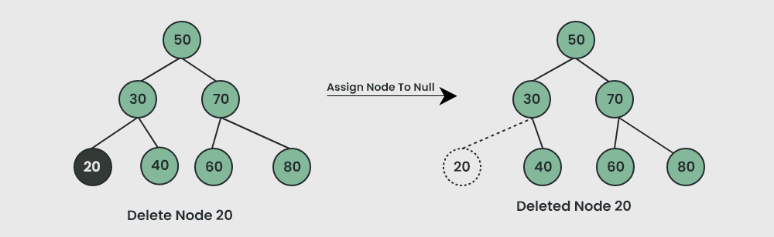
Case 1: Node with No Children
Notes:
🌟 Purpose: Explain how to handle the deletion of a node that has no children (a leaf node) in a Binary Search Tree (BST).
✅ What should I be doing?
Use the visual diagram to illustrate the process of deleting a leaf node.
Explain why this case is straightforward and its impact on the tree structure.
🎙 What should I be saying?
This is the simplest case of node deletion: removing a node with no children, also known as a leaf node.
In this example, we want to delete the node with the value 20. Since it has no children, we simply remove it by assigning its parent’s reference to null.
Notice how the structure of the tree is preserved, and all other nodes remain unaffected.
This case is straightforward because there’s no need to reassign or reorganize other nodes in the tree.
🙌🏽 How should I engage students?
Ask: "Why do you think deleting a leaf node is simpler than deleting a node with one or two children?"
Encourage: "Let’s look at another node in this tree—can you identify another leaf node? How would we delete it?"
Challenge: "What would happen if we were to accidentally leave a reference to the deleted node? How might that affect the tree?"

Slide 21
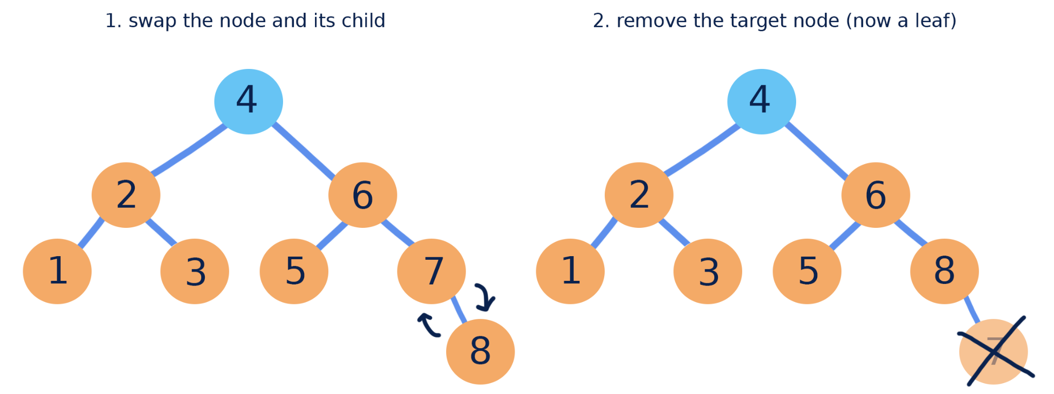
Case 2: Node with One Child
Notes:
🌟 Purpose: Explain how to handle the deletion of a node with one child in a Binary Search Tree (BST).
✅ What should I be doing?
Use the visual diagram to walk through the steps of deleting a node with one child.
Highlight how the parent node is reconnected to the child of the deleted node.
🎙 What should I be saying?
In this case, we’re deleting a node that has one child. This is a little more complex than deleting a leaf node but still manageable.
Let’s take a look at the example. Here, we’re deleting the node with the value 7, which has a single child, 8.
Step 1: We connect the parent of the node being deleted (in this case, 6) directly to the child of the node (8).
Step 2: The node with the value 7 is now effectively a leaf node, so we can remove it from the tree.
This ensures that the BST structure remains intact, and we maintain the ordering property.
🙌🏽 How should I engage students?
Ask: "Why do you think it’s important to directly link the parent node to the child of the deleted node? What could go wrong if we didn’t do this?"
Encourage: "Let’s identify another node in this tree that has one child. What would happen if we deleted it using the same steps?"
Challenge: "What do you think happens if the node being deleted is the root and has only one child? How might this case differ?"

Slide 22
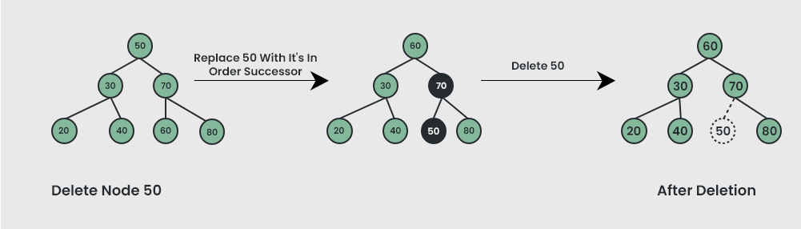
Case 3: Node with Two Children
Notes:
🌟 Purpose: Explain the process of deleting a node with two children in a Binary Search Tree (BST) while maintaining the tree’s structure and properties.
✅ What should I be doing?
Use the visual diagram to walk students through the steps of deleting a node with two children.
Explain the concept of the in-order successor and why it is used.
🎙 What should I be saying?
When deleting a node with two children, the process is a bit more complex because we need to ensure the tree remains structured and satisfies the BST properties.
In this example, we are deleting the node with the value 50, which has two children: 30 and 70.
Step 1: Find the in-order successor of the node being deleted. This is the smallest value in the right subtree. Here, the in-order successor is 60.
Step 2: Replace the value of the node to be deleted (50) with the value of the in-order successor (60).
Step 3: Delete the in-order successor node (60) from its original position. Since the in-order successor node will have at most one child, we can delete it using the method we discussed in Case 1 or Case 2.
After these steps, the tree remains a valid BST with the same ordering properties.
🙌🏽 How should I engage students?
Ask: "Why do you think we use the in-order successor when deleting a node with two children? Could we use another value instead?"
Encourage: "Let’s identify another node in this tree with two children. How would you approach deleting it?"
Challenge: "What happens to the tree’s structure if we accidentally delete the wrong node during this process? Why is the in-order successor or predecessor critical?"

Slide 23
Why is finding the minimum value node in the right subtree important when deleting a node with two children?
It ensures that the tree remains balanced after deletion.
It helps in finding the largest node in the right subtree.
It replaces the deleted node with the smallest value greater than the deleted node, maintaining the BST properties.
It simplifies the deletion process by removing a leaf node.
Notes:
🌟 Purpose: Test and reinforce students’ understanding of why the minimum value node in the right subtree is critical when deleting a node with two children in a Binary Search Tree (BST).
✅ What should I be doing?
Read the question aloud to ensure clarity and encourage students to think critically.
Facilitate participation by prompting students to share their answers in the chat or poll.
🎙 What should I be saying?
When deleting a node with two children, we need to replace it with the minimum value node from the right subtree. But why is this step so important?
Look at the options and consider the role of the in-order successor in maintaining the structure and properties of the BST.
Take a moment to review the choices. Submit your response—A, B, C, or D—and let’s discuss why the correct answer is the best fit.
🙌🏽 How should I engage students?
Acknowledge responses:
If students choose A: "Not quite. The in-order successor doesn’t guarantee balance—it simply preserves the BST properties."
If students choose B: "Interesting thought! However, we’re specifically looking for the smallest node greater than the deleted node, not the largest."
If students choose D: "Close, but the purpose isn’t simplification—it’s about maintaining the BST’s order."
Reinforce correct answer: "The correct answer is C. By replacing the deleted node with the smallest value greater than it, we ensure that the BST properties are preserved. This is why the in-order successor is chosen—it guarantees that all nodes in the left subtree are smaller and all nodes in the right subtree are larger."
Ask: "Can you think of any situations where finding the in-order predecessor (the largest value in the left subtree) might be used instead?"

Slide 24
Problem Set Validator Demo
Problem Set Validator email sent out a few hours ago
We will demo right before the break!
Totally optional tool that we built based on you guys’ feedback.

Slide 25

Break Time!
Take 5 mins to step away from the computer. Feel free to turn off your camera and return promptly after 5 mins.
Notes:
🌟 Purpose: Provide a short break to refresh and re-energize.
✅ What should I be doing?
Announce the break and remind students to return on time.
Play the countdown timer video (be sure to share sound).
🎙️ What should I be saying?
Let’s take 5 minutes to step away from the screen. Be sure to return promptly.

Slide 26
Collaborative Problem Solving
60 minutes

Slide 27
60 minutes
🏃🏽 Navigate to your breakout room.
👋🏽 Introduce yourselves!
🧑🏽‍💻 Work on the problems for your selected unit.

Slide 28
Wrap Up
10 minutes

Slide 29
Notes:
🌟 Purpose: End the session on a positive note.
✅ What should I be doing?
Prompt students to share their reflections in the chat.
🎙️ What should I be saying?
Let’s celebrate your wins. Share one good thing you learned or accomplished today!
🙌🏽 How should I engage students?
Read a few responses aloud and celebrate with enthusiasm.

Slide 30


Session Survey Time!
Notes:
🌟 Purpose: Gather feedback to improve future sessions.
✅ What should I be doing?
Share the survey link and emphasize its importance.
🎙️ What should I be saying?
Your feedback helps us make these sessions even better. Please take a moment to complete the survey.
🙌🏽 How should I engage students?
Thank students for their input and explain how feedback has been used in the past.

Slide 31

Final Reminders
Finish the problem sets for additional practice
Take the weekly HackerRank assessment by Sunday @ midnight
Visit a Study Hall Session to deepen your understanding, work through challenges, and connect with course material alongside your peers!
Notes:
🌟 Purpose: Reinforce key tasks and deadlines.
✅ What should I be doing?
Summarize next steps and encourage continued engagement.
🎙️ What should I be saying?
Don’t forget to complete the problem sets and take the HackerRank assessment by Sunday!
🙌🏽 How should I engage students?
Encourage students to ask any lingering questions before signing off.

